Slide 1
Lecture 7
Conditional Distributions
Multivariate Distributions

Slide 2

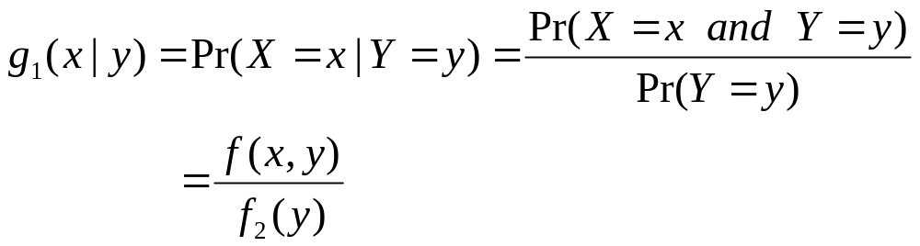
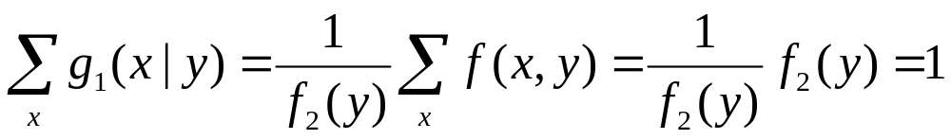
Conditional Distributions
Suppose that X and Y have a discrete joint distribution for which the joint p.f. is f.
For any y such that , the conditional p.f. of X given that Y=y is:
Check:
Notes:
For example, gender and education. Draw the contingency table. How do we calculate the conditional distribution of education level given a person being female? How do we calculate the conditional distribution of gender given a person being in college? The difference from conditional probabilities in Chapter 2 lies in the specification of random variable (use numbers rather than outcomes).

Slide 3

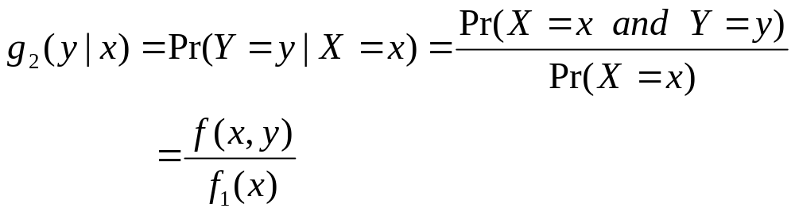
Similarly, for any x such that , the conditional p.f. of Y given that X=x is:

Slide 4
Example: Education and Monthly Personal Income
Suppose that education level (X) can take values 1=“below college”, 2=“college”, and 3=“above college”. Suppose that monthly personal income (Y) can take values 1=“<2000”, 2=“2000-4999”, 3=“5000-9999”, 4=“>=10000”.

Slide 5
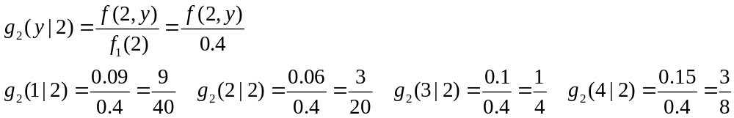
Example: Education and Monthly Personal Income
Suppose that in certain population, the probabilities for different combinations of education level and monthly personal income are given by the table below.
  Y
  1 2 3 4
  1 0.2 0.1 0.06 0.04
  X 2 0.09 0.06 0.1 0.15
  3 0.01 0.03 0.08 0.08
  What is the conditional p.f. of Y given X=2?
The conditional probabilities proportional to the 2nd row, but
sum up to 1!
Notes:
Talk about what “proportional to” means here. Given x, f(x) is a fixed constant, so g(y|x) is proportional to f(x,y).

Slide 6
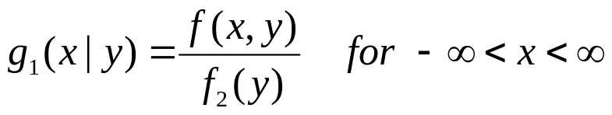
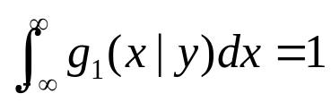

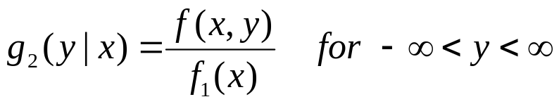
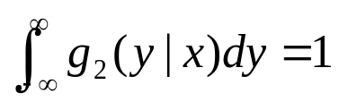
Continuous Conditional Distributions
Suppose that X and Y have a continuous joint distribution. For any y such that , the conditional p.d.f. of X given that Y=y can be defined as
Similarly, for any x such that , the conditional p.d.f. of Y given that X=x can be defined as
Notes:
Draw a circle or a cylinder (the case when (x,y) is uniformly distributed in a circle). Discuss what is the conditional distribution of y given x=0.5, etc.

Slide 7
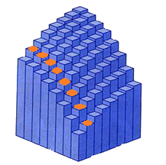
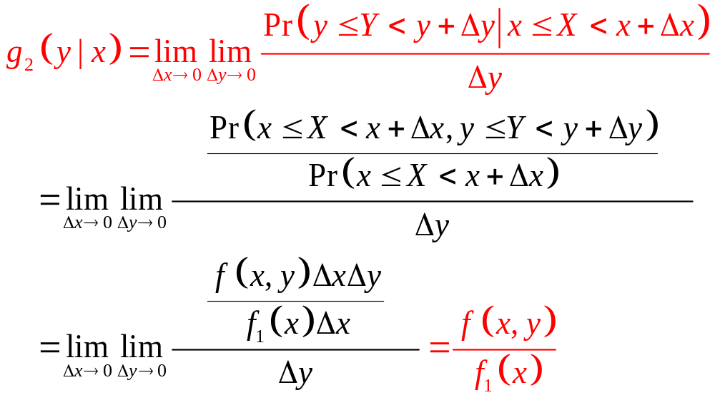
Understanding Conditional p.d.f.

Slide 8
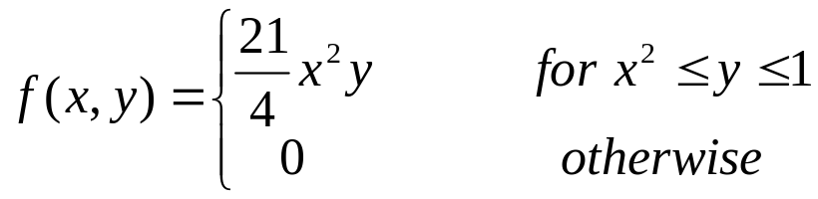
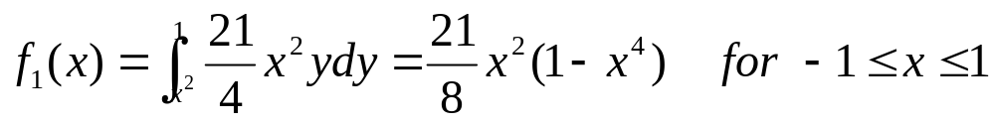

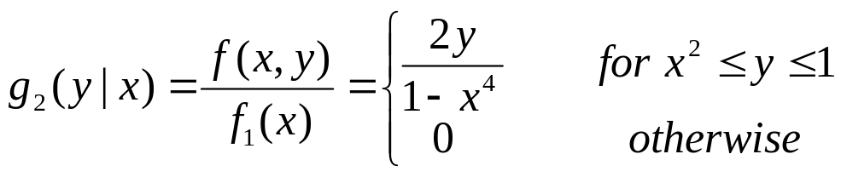
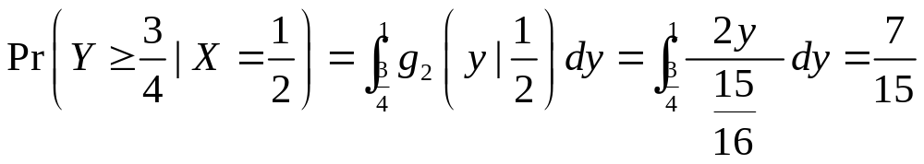
Example
Suppose the joint p.d.f. of X and Y is:
For –1<x<0 or 0<x<1, , then
If x=1/2, then
Notes:
For description of conditional distributions, we need to pay attention to the domain of the conditioning-on variable, as well as the conditional domain of the conditional variable.

Slide 9


Construction of The Joint Distribution
For any y such that f2(y)>0 and any x,
If f2(y0)=0 for some y0, then we can assume that f(x,y0)=0 for all values of x.
Thus, for all values of x and y,
Similarly,
Notes:
The joint distribution is not zero only when the conditioning on variable is in its domain and the conditional variable is in its conditional domain.

Slide 10
Example
Suppose that a point X is chosen from a uniform distribution on the interval (0,1). After X=x has been observed, a point Y is then chosen from a uniform distribution on the interval (x,1). What is the marginal p.d.f. of Y? What is the conditional p.d.f of X given Y=y?
Notes:
f(x,y) contains all the information we need to know about X and Y.
So are the pairs of distributions [f(x),g(y|x)] and [f(y),g(x|y)]. Knowing f(x) and f(y), or f(x) and g(x|y), or f(y) and g(y|x), or g(y|x) and g(x|y) do not yield all the information.

Slide 11
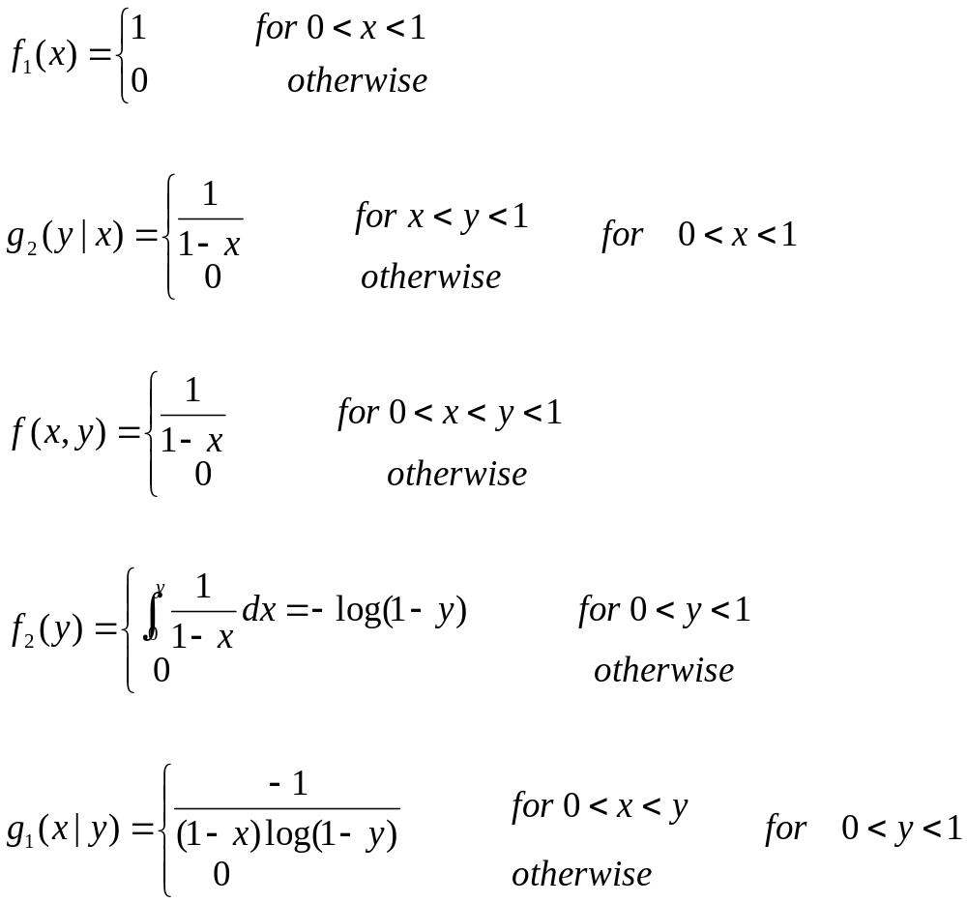
Notes:
Emphasize the importance of domain.

Slide 12

Independent Random Variables
Suppose that X and Y have a continuous joint distribution.
X and Y are independent
Notes:
g(x|y)=f(x) or g(y|x)=f(y) again sayes that knowing y does not change the judgement about the distribution of x, or vice versa.

Slide 13

Multivariate Distributions
The joint distribution of more than two random variables is called a multivariate distribution.
Joint d.f. of n random variables X1,…Xn is
We can use the random vector X=(X1,…,Xn), and let x=(x1,…,xn), then the d.f. for the random vector becomes F(x), which is defined on n-dimensional space

Slide 14


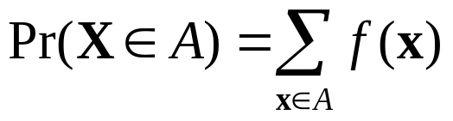
Discrete Distributions
The random vector X=(X1,…,Xn) can only take a finite number or an infinite sequence of different possible values (x1,…,xn) in
The joint p.f. for any point x=(x1,…,xn) in :
Or simply
For any subset

Slide 15
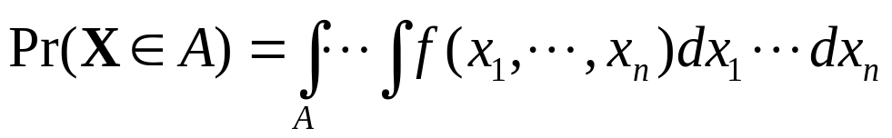
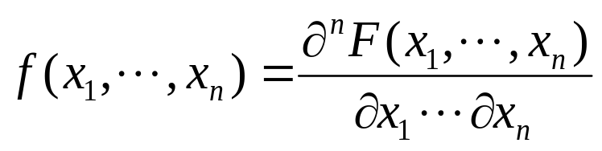
Continuous Distributions
There is a nonnegative function f defined on
such that for any subset
The function f is the joint p.d.f. of X=(X1,…,Xn)
The joint p.d.f. can be derived from the joint d.f. by
at all points (x1,…,xn) where the derivative exists.

Slide 16
Mixed Distributions
Some of the random variables have discrete distributions while the other variables have continuous distributions. The joint distribution of X1,…,Xn would then have a mixed distribution.

Slide 17
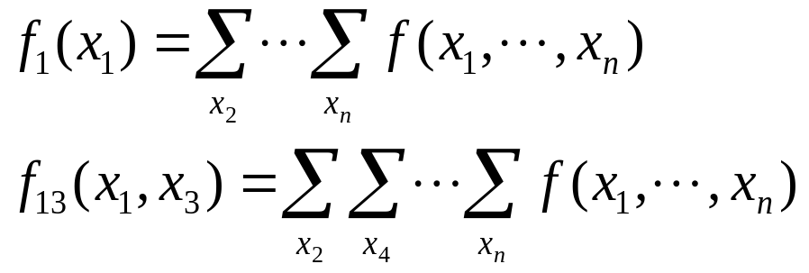
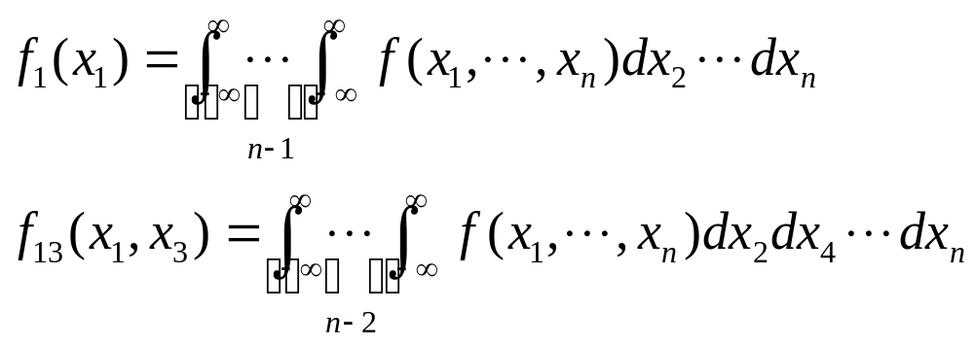
Marginal Distributions
Marginal p.f. (discrete):
Marginal p.d.f. (continuous):

Slide 18
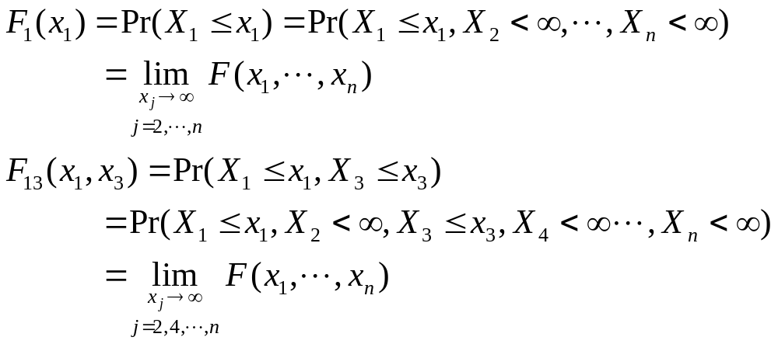
Marginal d.f. (discrete or continuous):

Slide 19
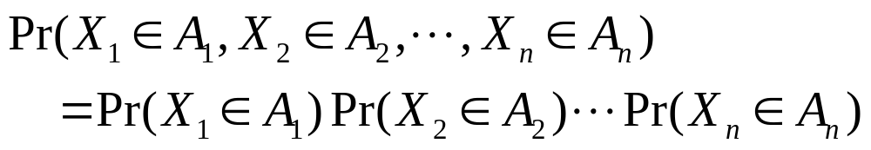
Independent Random Variables
n random variables X1,…,Xn are independent if, for any n sets A1,A2,…,An of real numbers,

Slide 20
Random Sample
Given a p.f. or p.d.f. f, we say that n random variables X1,…,Xn form a random sample from this distribution if
  these variables are independent;
  the marginal p.f. or p.d.f. of each of them is f.
The joint p.f. or p.d.f. g is specified at all points (x1,…,xn) in as:
We say that the variables are independent and identically distributed (i.i.d). n is called the sample size.
Notes:
Usually used in random sampling. What is random here? (Not the characteristics of each person or item, but the random selection process.) Example, draw 100 students to investigate the height of 40,000 PKU students.

Slide 21
Examples of Random Sample
The heights of 50 undergraduate students randomly selected from Peking University with (or without) replacement (sample size=50).
The income of 1000 people randomly selected from the Beijing city (sample size=1000).
The defectiveness indicators (1=defective, 0=non-defective) of 100 randomly selected items produced by certain factory (sample size=100).

Slide 22
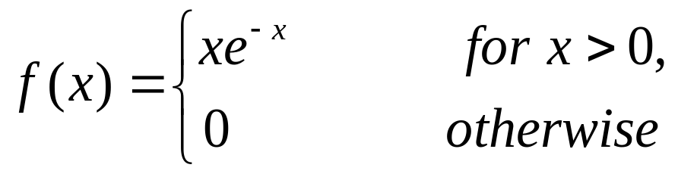
Example: Lifetimes of Light Bulbs
Suppose the lifetimes of light bulbs produced in a certain factory are distributed according to:
What is the joint p.d.f. for the lifetimes of a random sample of n light bulbs is drawn from the factory’s production?

Slide 23

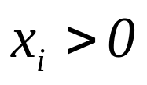
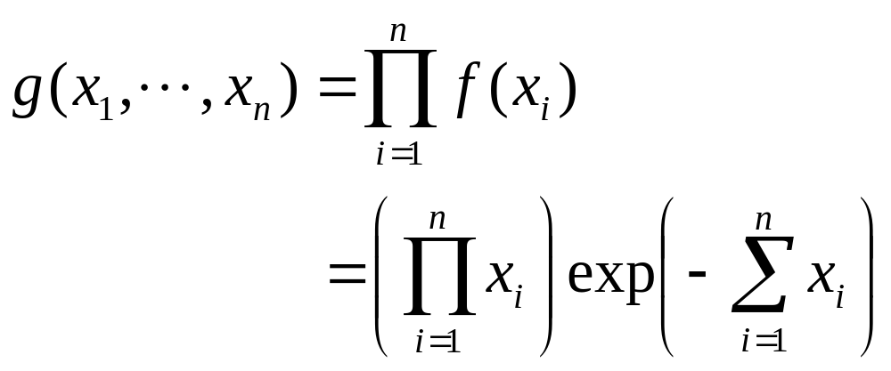
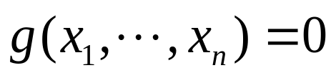
Note: we will use exp(v) to denote
If for i=1,…,n
Otherwise,

Slide 24


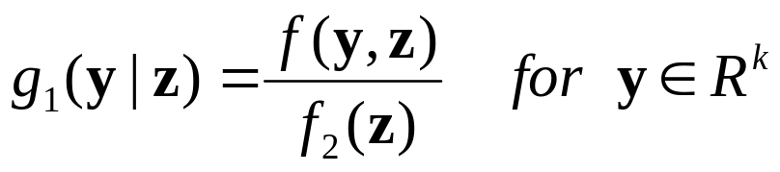
Conditional Distributions
In general, suppose the random vector X is divided into a k-dimensional random (sub)vector Y and a (n-k)-dimensional random (sub)vector Z.
  The n-dimensional p.f. or p.d.f. of (Y,Z) is f.
  The marginal (n-k)-dimensional p.f. or p.d.f. of Z is f2.
  Then for any given point such that , the conditional k-dimensional p.f. or p.d.f. g1 of Y given Z=z is defined as:
Notes:
Similar as before. Only that the issues are discussed using the vector notation.

Slide 25
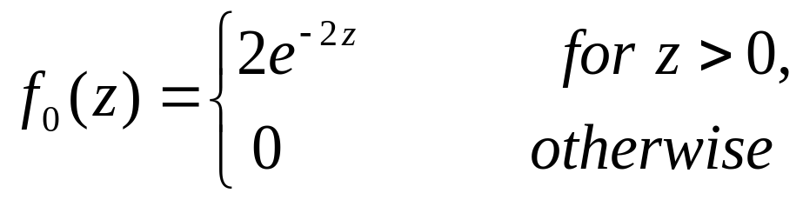
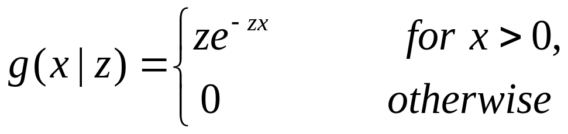
Example
Suppose that Z is distributed as:
Given Z=z>0, X1 and X2 are i.i.d, each has a conditional p.d.f. as:
What is the marginal joint p.d.f. of X1 and X2?

Slide 26
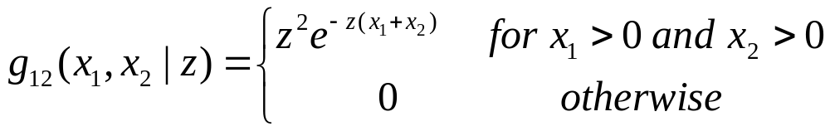
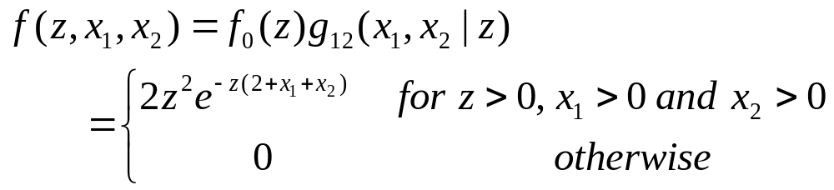
Solution: The joint conditional p.d.f. of X1 and X2 given Z=z>0 is:
The joint p.d.f. f of Z, X1 and X2 is:
Notes:
g(x1,x2|z)=g(x1|z)g(x2|z)
Again, pay attention to the domain.

Slide 27
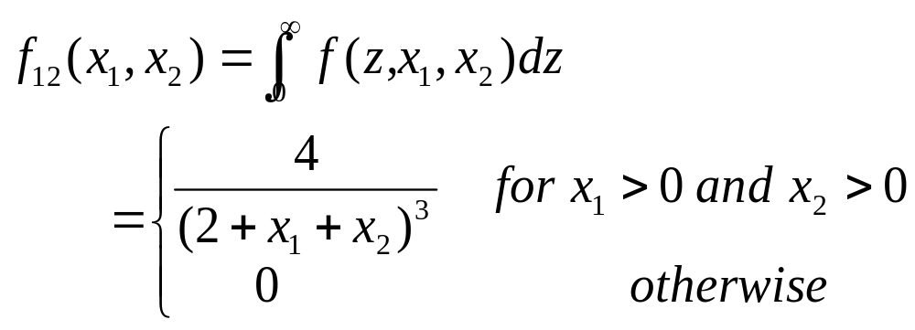
The marginal joint p.d.f. of X1 and X2 is:

Slide 28
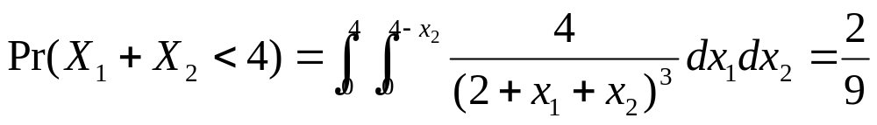
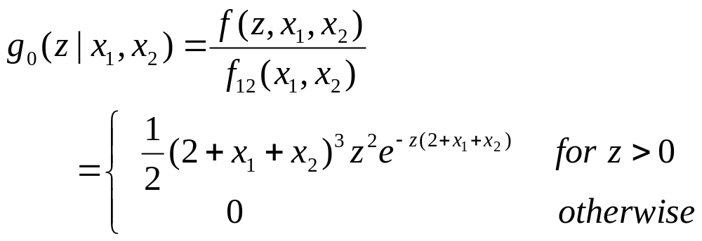
Further,
The conditional p.d.f. of z given X1=x1 and X2=x2 (x1>0 and x2>0) is

